Slide 1
Implementing Acceleration Structures to Optimize a Sphere Tracing Ray Marcher
Musschoot Adriaan - GD
Samyn Koen - Supervisor
Geeroms Kasper - Coach

Slide 2
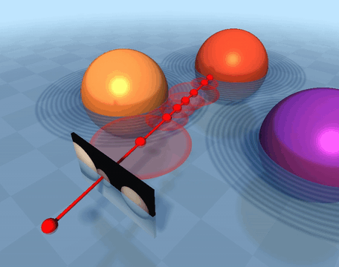
Sphere Tracing
For each pixel cast ray
March forward along ray
Retrieve the distance value to the scene
Objects represented by SDFs

Slide 3
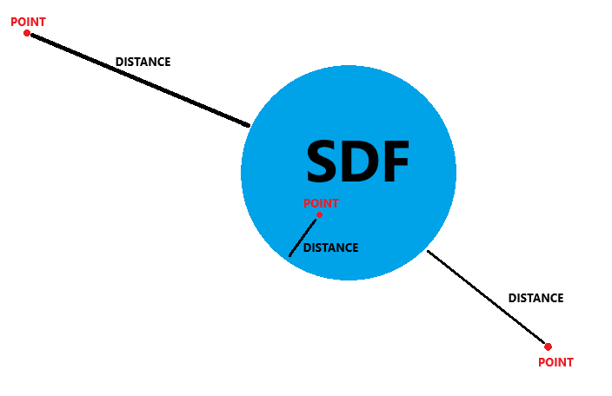
SDFs
Not a file format
Mathematical formulas
Small memory footprint

Slide 4
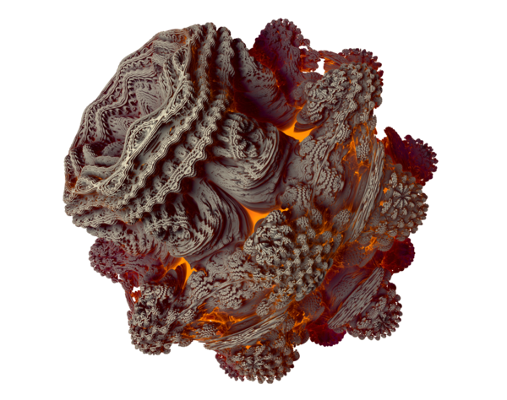
Sphere Tracing Is Slow
Many steps for each ray
Heavy computations complex shapes

Slide 5
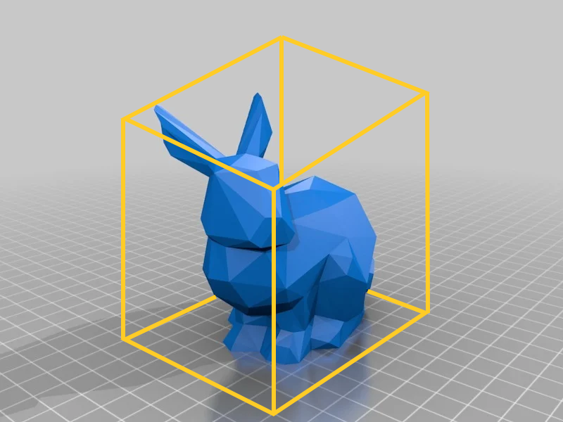
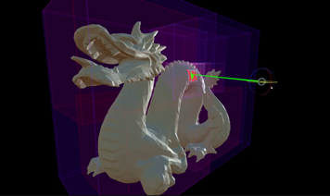
Acceleration Structures
AABB
BVHTree

Slide 6
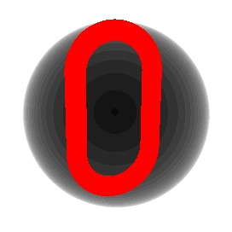

Early Out
Sphere
Box

Slide 7

Construction Early Out Sphere

Slide 8

Construction Early Out Box

Slide 9
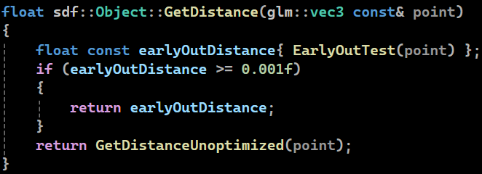
Early Out Usage

Slide 10

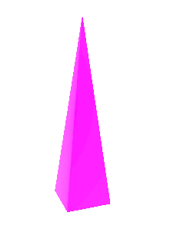
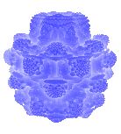
Comparison Early Out
Object | Link | Pyramid | Mandelbulb
No early out | 0.0108ms | 0.0132ms | 0.0469ms
Sphere early out | 0.0098ms | 0.0143ms | 0.0112ms
Box early out | 0.0094ms | 0.0106ms | 0.0139ms

Slide 11
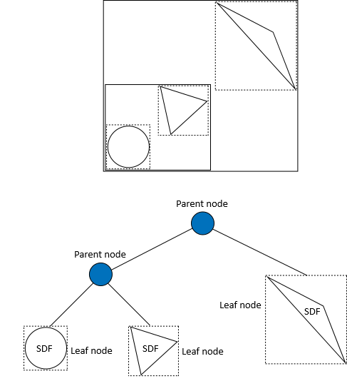
BVHTree

Slide 12
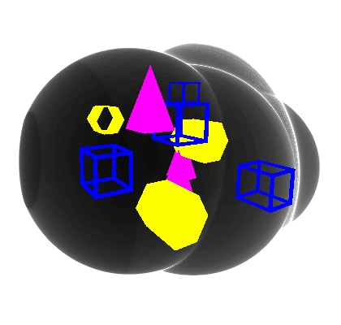
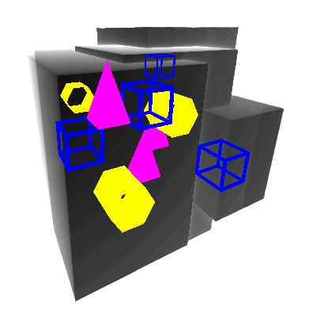
BVHTree
Sphere
Box

Slide 13
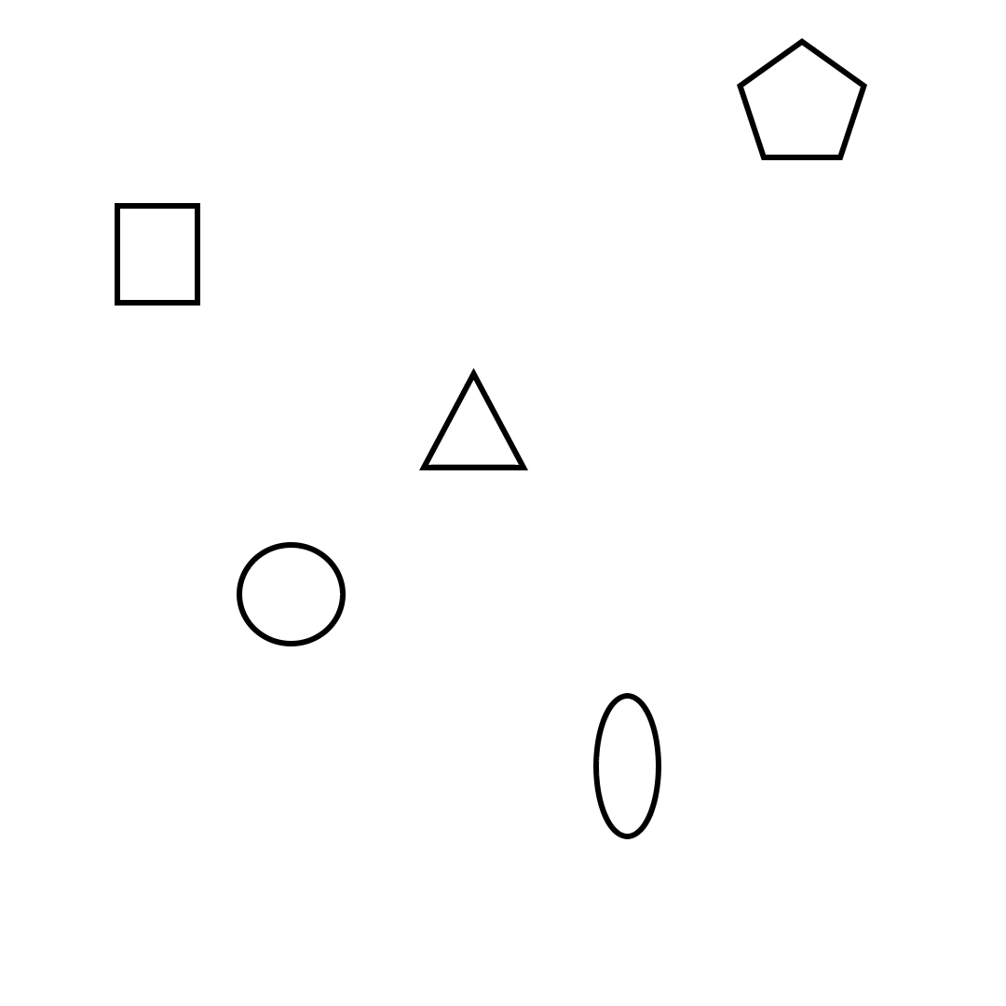
BVHTree construction
For every node
Origin
Sphere radius / box extent
Surface area heuristic
Repeated until singular object remains

Slide 14
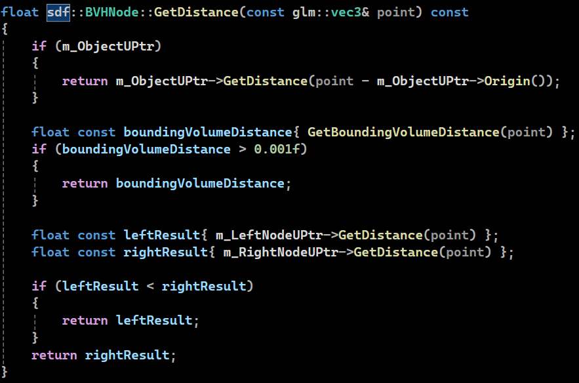
BVHTree usage

Slide 15
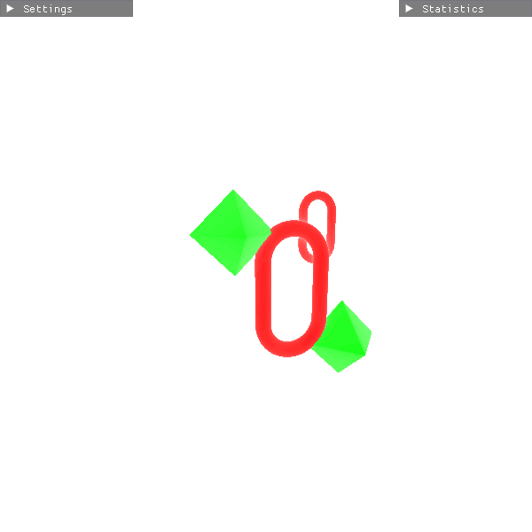
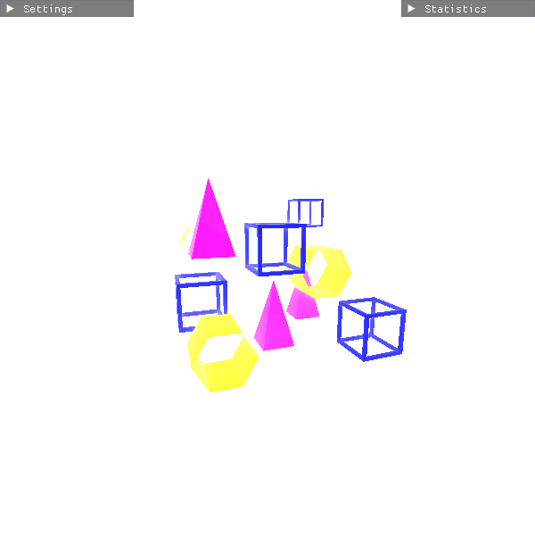
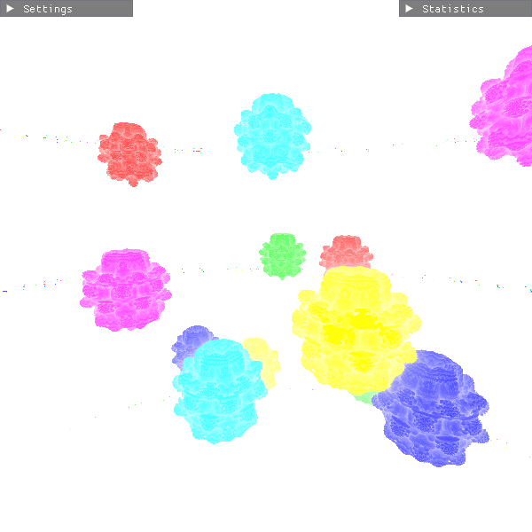
Comparison BVHTree
Scene complexity | Simple | Medium | Complex
No BVHTree | 0.0255ms | 0.0963ms | 0.2298ms
Sphere BVHTree | 0.0131ms | 0.0370ms | 0.0648ms
Box BVHTree | 0.0146ms | 0.03269ms | 0.0429ms

Slide 16
Conclusion
Early out → object dependent
BVHTree → always faster even in simple scenes

Slide 17
Future Work
Only tested in static scenarios
Construction and approximation once at the start
GPU Implementation

Slide 18
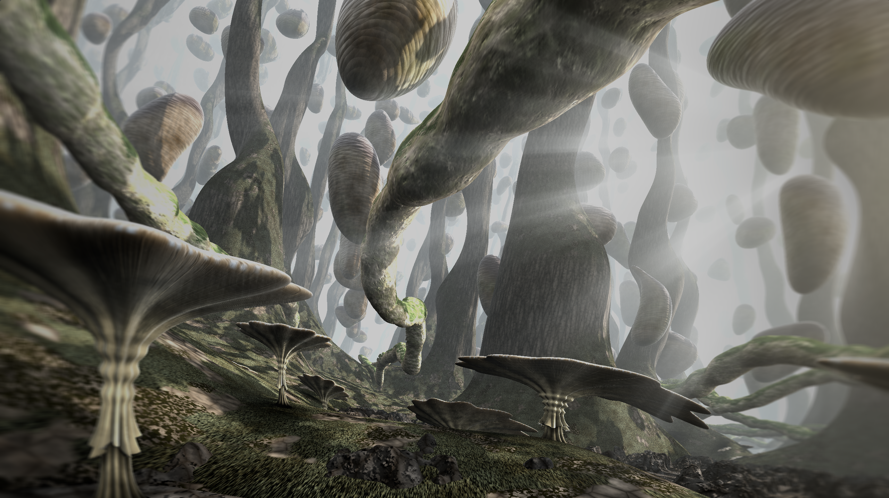
Questions?

